Slide 1
Bivariate Probability Distribution -- for continuous random variables (Section 5.2,5.3)
Lecture 21

Slide 2
Recap
Exam #2 Thursday 4/11
Bivariate discrete distributions: joint, marginal and conditional

Slide 3
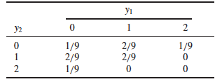
Review
Joint probability function for discrete random variables: P(y₁, y₂),
The joint CDF F(y₁, y₂)
The marginal probability function
Conditional
Univariate:
Continuous random variable

Slide 4
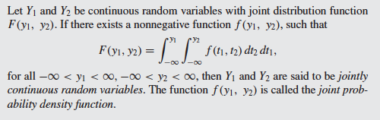
Two random variables are said to be jointly continuous if their joint cumulative distribution function (joint CDF) F(y₁, y₂) is continuous in both arguments.
Definition 5.3 (Page 227):
Jointly continuous random variable and joint pdf

Slide 5
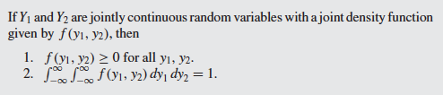
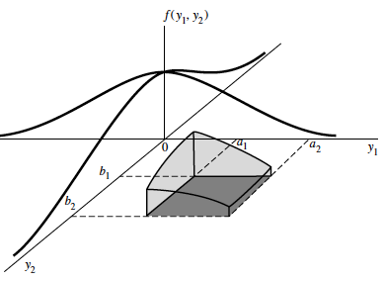

Theorem 5.2 (page 228) properties of joint pdf
2 properties of
univariate pdf?
For the univariate continuous case, areas under the pdf over an interval correspond to probabilities
Similarly, for the bivariate pdf f (y₁, y₂), volumes under this surface correspond to probabilities.
P(a₁ ≤ Y₁ ≤ a₂, b₁ ≤ Y₂ ≤ b₂) is the shaded volume shown in Figure 5.2 and is equal to

Slide 6
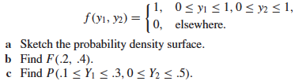
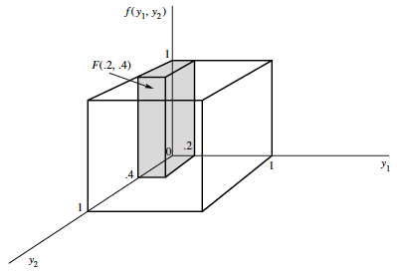
Example 5.3 (Page 229)
Suppose that a radioactive particle is randomly located in a square
with sides of unit length. That is, if two regions within the unit square
and of equal area are considered, the particle is equally likely to be in
either region. Let Y₁ and Y₂ denote the coordinates of the particle’s location.
A reasonable model for the relative frequency histogram for
Y1 and Y2 is the bivariate analogue of the univariate uniform density function:

Slide 7
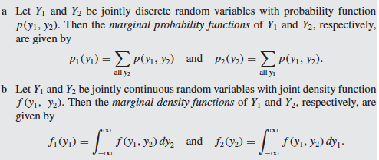

Marginal probability/density function
=?

Slide 8
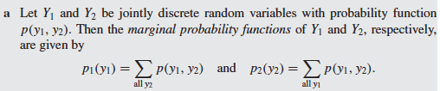
Marginal probability functions of Y₁ and Y₂ (discrete random variables, definition 5.4 a, page 236)
=?
In the following table, what is the marginal probability functions of Y₁ and Y₂?
 |  |  | Y₁
 |  | 0 | 1 | 2
 | 1 | 1/3 | 0 | 1/6
Y₂ | 2 | 0 | 1/6 | 0
 | 3 | 1/6 | 0 | 1/6
P(Y₁=0)=? P(Y₂=1)=?
P(Y₁=1)=? P(Y₂=2)=?
P(Y₁=2)=? P(Y₂=3)=?

Slide 9

Find the marginal pdf f(y₁) and f(y₂) for Y₁ and Y₂ which have the following joint pdf
The marginal pdf for Y₁: f(y₁)=1 for 0 <= y₁ <= 1, and f(y₁)=0 elsewhere.
The marginal pdf for Y₂: f(y₂)=1 for 0 <= y₂ <= 1, and f(y₂)=0 elsewhere.

Slide 10

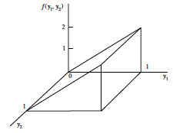
Page 237

Slide 11

Exercise 5.6 a (Page 233): The joint density function for two random variables Y₁ and Y₂ is

